Slide 1

BabyCare System Project Final Presentation
Surveillance & Locating System Resolution
Wireless Sensor Networks Fan Zhang, Yu Wang, Ying Liu

Slide 2
Outline
Introduction
System Description and Design
System Implementation
Experimental Research
Conclusions and Future Works
Video Performance
References

Slide 3
Introduction
Our Focus:
Low-cost, easy-to-use, reliable, RF based, surveillance system to monitor/locate kids, and alarm when they are out of specific safe region
Requirements and Problems:
Locating algorithm
Front/Back-End programming
Data collection and training module
Environment Evaluation

Slide 4
System Description and Design
Localization Methodology:
Using radio signal information from wireless transmitters, such as 802.11base stations or sensor network nodes, it is possible to determine the location of a roaming node with close to meter-lever accuracy
Radio-Frequency (RF) based localization
RADAR, Cramer-Rao bound(CRB),

Slide 5
System Description and Design
Why RF-based
It’s the “least common denominator” for most wireless sensor networks
Can supplement other wireless sensor networks with location tracking for little or no additional cost
Benefits of no additional hardware
Lower cost and smaller size
“Robust” to the environment
Doesn’t require line of sight
Is not sensitive to variations of light and temperature

Slide 6
System Description and Design
RSSI (Received Signal Strength Indication)
RSSI technique together with enhancement algorithm is proposed to cater this solution.
Use empirical results of signal strength obtained from beacon nodes to determine distance
RSSI 8 or 10 bit-number, obtained from physical layer, MICA2/MICA2DOT motes (Chipcon CC2420) provides RSSI on the ADC(Analog to Digital Converter) channel 0 and is available to the software running on the motes as a 10-digit number

Slide 7
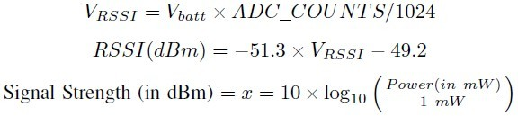
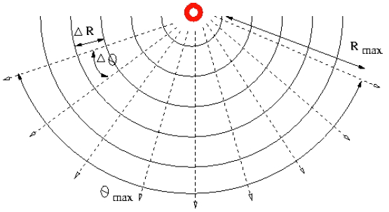
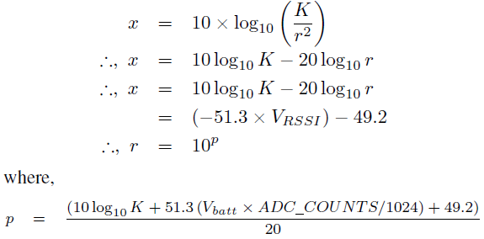
System Description and Design
ADC Counts(10-bits) to RSSI in dBm
RSSI in dBm is a decreasing function of V_{RSSI} in volts
Simplicity
Assume free space signal propagation and have the following relation for power per square meter (P/m²)

Slide 8
System Description and Design
Chipcon CC2420 RSSI formula :
RSSI = -(10n log₁₀d + A),
n: signal propagation constant or exponent
d: Distance from sender
A: Received signal strength at 1 meter distance
Calibration for RSSI values
Raw RSSI values are collected at several predefined distances from the respective references node at the test area where it is implemented.
The calibration values are then processed to obtain a suitable propagation constant for each reference node.

Slide 9
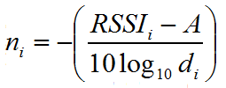
System Description and Design
A series of calibration shows that uniform computation of signal propagation constant in order to determine the distance according to signal strength exhibits some drawbacks. This verified that different mediums (free space, glass, and wall) surrounding the reference nodes affect the signal attenuation differently. Therefore, if only a single propagation constant is used for all reference nodes, miscalculation of the distance occurs. The calibrated propagation constant takes obstacles into account and it is calculated by reversing the linear RSSI equation as shown in
The value A is obtained in a no-obstacle one-meter distance signal strength measurements from the reference nodes.

Slide 10
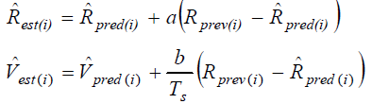

System Description and Design
Complexity smoothing algorithm :
Minimize the dynamic fluctuation of radio signal received from each reference node when the emit node is moving
Estimation:
Prediction:
R_{est(i)} , R_{pred(i)}, : the ith smoothed estimate range; the ith predicted range,
R_{prev(i)} , V_{est(i)}: the ith measured range; the ith smoothed estimate range rate
V_{pred(i)} : the ith predicted range rate.
a, b : gain constants
Ts : time segment upon the ith update

Slide 11
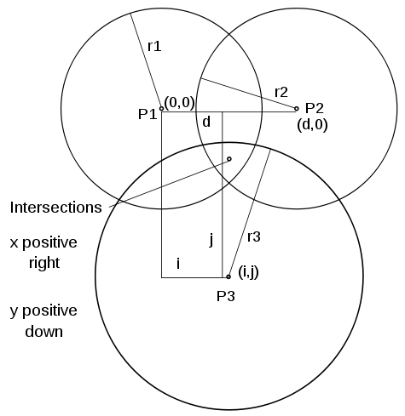
System Description and Design
Position Estimation:
To estimate the position of the emit node, at least three reference nodes in the network must be able to detect and measure the emit node’s signal strength.
Trilateration Method :
a method to determine the position of an object based on simultaneous range measurements from three reference nodes at known location.

Slide 12

System Description and Design
Iterative method :
derive blind node position according to the estimated distance resolved from filtered RSSI and the calibrated constant.
The algorithm requires the coordinates of at least three reference nodes (xi, yi) and the distances di between the blind node and the respective reference nodes, which are estimated in the previous subsection. A trivial estimated position (xe, ye) is needed to start the algorithm.
This estimated position represents the latest calculated position. The algorithm then calculates the difference between the measured and estimated distance, as defined below:

Slide 13
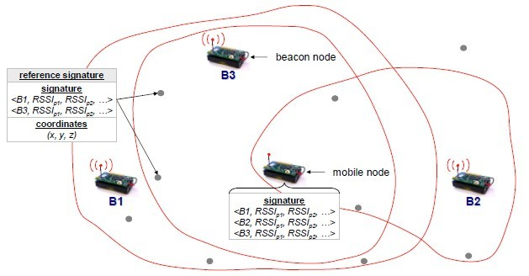
System Description and Design
Overviews:
Platform : Static motes + Movable mote + Station
Implementation: Three Phases

Slide 14
System Description and Design
Platform – TelosB/TinyOS
Implemented on TelosB mote platform using TinyOS os.
Low-power operation
Working by battery, easy to operate off
Small size
Easy to embed in environment and equipment
Expansibility and Support
Widely used and easy to integrate

Slide 15
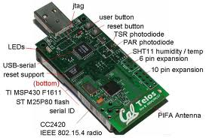
System Description and Design
TelosB Mote Platform
Low-power Wireless Sensor Module
2.4GHz 802.115.4 radio chip CC2420
250 kbps, High Data Rate Radio
Data collection and programming via USB
TI MSP430 MCU (10kB RAM)
Open-source
Datasheets
http://www.willow.co.uk/TelosB_Datasheet.pdf

Slide 16
System Implementation
Phase I : (Infrastructure)
Placement of static modes in specific region
Construction of a “signal strength map” or reference signature database , by going around the environment at known locations and collecting samples
Back-end base station
PC with Ubuntu, TinyOS, Java app, GUI

Slide 17
System Implementation
Phase II : (Distance estimation)
Identify if the emit mode beyond the region
Low accuracy is allowed
Empirical Method - Linear progression
RSSI = Ad + B (A, B parameters)
Based on abundant experimental training and testing, worked out values of A, B .
RSSI = -1.125 d + 26.5

Slide 18
System Implementation
Phase III : (Applied Functions)
UI (User Interface)
Use UI to control the input in TinyOS
Bring a new friend Camera – used for monitoring.
Alarm
Music display if the carrier is beyond regions
Reminder (Periodical check)
checking the position periodically, the kid cannot stand still for 30 mins, 1 hr, 2 hrs, 3 hrs… and alarm(maybe passed by, fainted, fall down or drop the emitor)
checking the signal. If lost, alarm(taken by UFO)

Slide 19
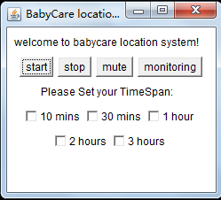
System Implementation
GUI (Graphic User Interface)
This value goes into your “check()” function. Ex: every 30 minutes make a checking.

Slide 20
Experimental Research
* Alternative approach:
Empirical measurement of received radio signals to estimate location.
Database of radio signals+ known locations
Estimate position by query DB and compare

Slide 21
Conclusion and Future work
Achievements
Implemented an application system – Baby Care System
Tested previous RF localization theories
Created a new rapid linear function to estimate locations
Further work
To make BCS robust
To extended the BCS by build large WSN grids
Continue to work on Empirical measurement approach

Slide 22
Video Performance
http://www.youtube.com/watch?v=moEqgf51BfQ&feature=youtu.be
http://youtu.be/moEqgf51BfQ

Slide 23
Reference: (Partial)
Chipcon: CC2420 802.15.4 compliant radio,
http://www.chipcon.com. Analyze the TelosB Signal Strength vs. Distance http://pharos.ece.utexas.edu/wiki/index.php/How_to_Analyze_the_TelosB_Signal_Strength_vs._Distance
MoteTrack: Robust, Decentralized Approach to RF-Based Location Tracking, Konrad Lorincz and Matt Welsh. Poster presented at the Harvard Industrial Partnership (HIP), October 2004.
Cesare Alippi, Giovanni Vanini, “A RSSI-based and Calibrated Localization Technique for Wireless Sensor Networks”, In Proceeding of the Fourth Annual IEEE International Conference on Pervasive Computing and Communications Workshops (PERCOMW’06),2006.
Konrad Lorincz and Matt Welsh. Motetrack: a robust, decentralized approach to rf-based location tracking. Personal and Ubiquitous Computing.
Erin-Ee-Lin Lau, Erin-Ee-Lin Lau, “Enhanced RSSI-based Real-time User Location Tracking System for Indoor and Outdoor Environments”
Mohit Saxena, Puneet Gupta, Bijendra Nath Jain, “Experimental Analysis of RSSI-based Location Estimation in Wireless Sensor Networks”

Slide 24
Acknowledgements

